Slide 1
Project Presentation for CS598 DL4H in Spring 2023
Ambarish Tripathi and Debabrata Biswas {at37, dbiswas3}@illinois.edu
Group Id: 10 Paper Id: 85

Slide 2
Agenda
Introduction / Problem Description / HiCu Algorithm
Architecture / Approach taken in the paper
Implementation / Reproduction Attempts
Results (from Original Paper)
Results (After Code Modification)
Discussion / Conclusion

Slide 3
Introduction / Problem Description
Paper: "HiCu: Leveraging Hierarchy for Curriculum Learning in Automated ICD Coding" by Ren et al.
The HiCu paper addresses the problem of automated coding of medical diagnoses and procedures using the International Classification of Diseases (ICD) system.
Mapping clinical notes, discharge summaries, and patient profiles to ICD codes is a time-consuming and error-prone task.
The complex relationships between the many possible codes make automated ICD coding a challenging task.
The paper proposes a novel hierarchical curriculum learning approach to improve the accuracy and efficiency of automated ICD coding.
By leveraging the hierarchical structure of the ICD codes, the HiCu approach is designed to improve the model's ability to learn complex relationships between codes.
The importance of this problem cannot be overstated as it can help reduce costs for patients and providers, streamline medical workflows, and improve healthcare outcomes.

Slide 4
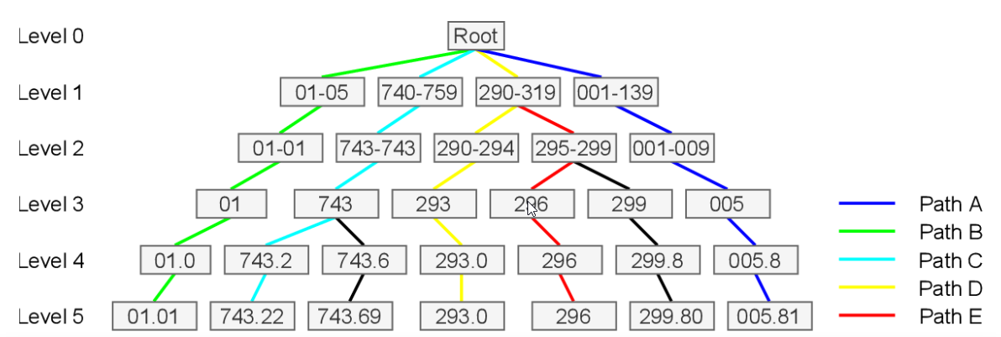
HiCu - Example ICD code label tree
HiCu Algorithm is a hierarchical curriculum learning approach that leverages the hierarchical structure of the ICD codes to improve the accuracy and efficiency of automated ICD coding.

Slide 5
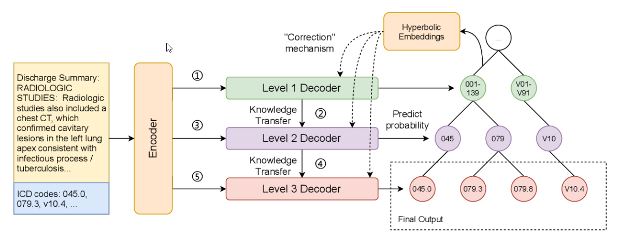
HiCu Architecture
Key Components:
Encoder-Decoder Framework: The HiCu architecture consists of an encoder-decoder framework that is combined with a hierarchical curriculum learning algorithm.
Sequential Training Algorithm: The model is trained in a sequential algorithmic framework, where simpler codes are learned before more complex codes. The model is first trained on labels at the first level of the label tree using a level one decoder and then proceeds to level two using a knowledge transfer mechanism.
Hyperbolic Embeddings: During training at each level, the hyperbolic embeddings of the ICD codes are used to guide the attention computation in the decoder. The hyperbolic embeddings allow the model to learn a representation of the ICD code hierarchy that is more structured and aligned with the hierarchical structure of the codes.
High-order Grouping of ICD Code Blocks: The HiCu algorithm uses a high-order grouping of ICD code blocks to create a two-level hierarchy. This modification of the HiCu algorithm is trained on the MIMIC-III dataset to verify its performance.

Slide 6
Implementation / Reproduction Attempts
Talk about Code changes/Implementation
The ICD-9 Code hierarchy has been flattened.
The result ICD codes follow 2 level depth - <root, code> (Ablation)
Reduce the Poincare/negative to 1.
Reproduction attempts
The original design hypothesis for multilevel ICD-9 has been altered.
Still using the same hyperparameters from the original paper to compare the changes.
Explain the process of reproducing the results
Flatten the ICD-9 hierarchy to <root, code> (only 2 level)
The loss function should get worst.
Discuss any challenges encountered during the reproduction attempts
Hardware limitations e.g GPU/CPU/RAM inadequate to run the entire dataset.

Slide 7
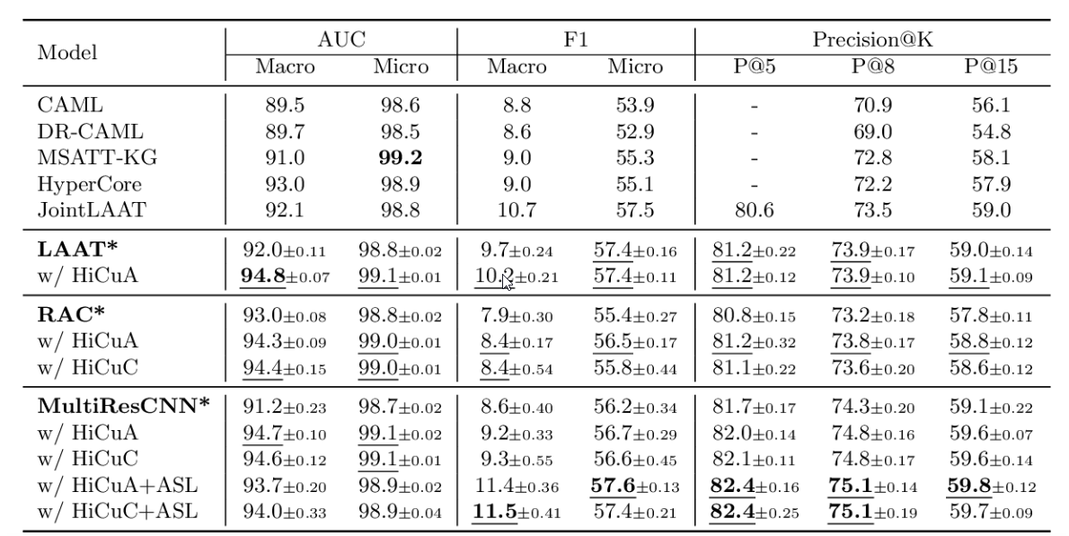
Results (from Original Paper)
MIMIC-III Full Code Results (in %). The results obtained are shown in means ± standard deviations from 10 random runs.
The first block in the table shows the baseline results reported in the papers.
The following three blocks specify three groups of experiments, each showing the baseline which was re-implemented in original paper (with *) and the corresponding models which were further evaluated with HiCu learning algorithm.
The bold values indicate the best results which was obtained from all experiments, whereas the underlined values indicate the best results among each experiment group, in the original paper.

Slide 8
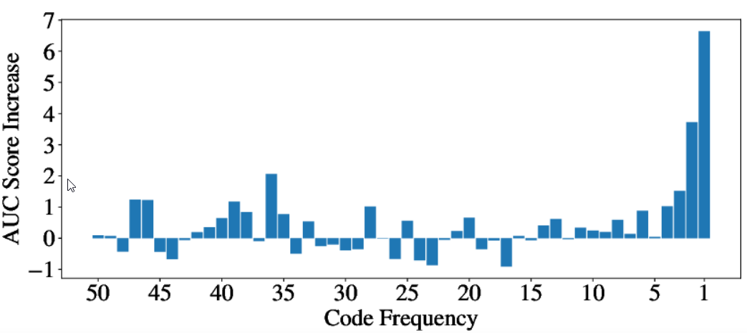
Results (from Original Paper) Contd..
AUC Improvements on Rare Codes:
AUC Score difference between vanilla MultiResCNN and (MultiResCNN w/ HiCuA+ASL).
ICD codes are grouped by their frequency (i.e. occurring times in ground truth).
This figure shows the increase of average AUC scores (in %) inside of each frequency group. For example, the size of the bar plot above code frequency ”1” indicates the increase of average AUC scores within the code subset that appears only once in the training set. The figure indicates a visible enhancement in rare code prediction.

Slide 9

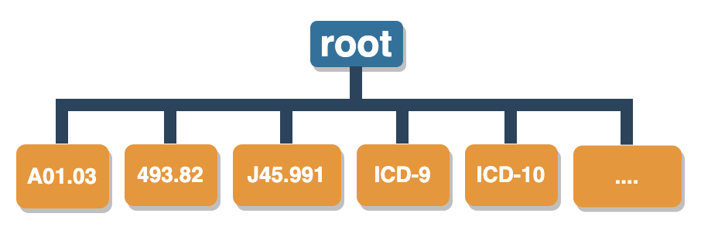
Ablation/Code Modification - 1
The following code has been modified to flatten the ICD-9 code:
source code - main.py

Slide 10
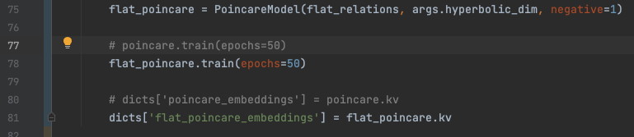
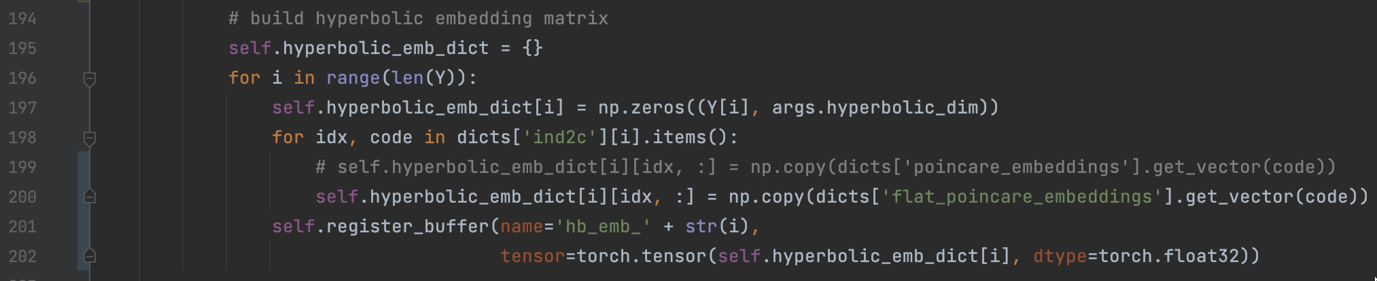
Ablation/Code Modification - 2
Sending the flattened hierarchy to Poincare model:
Using the flat Hierarchy to hyperbolic embedding matrix:

Slide 11
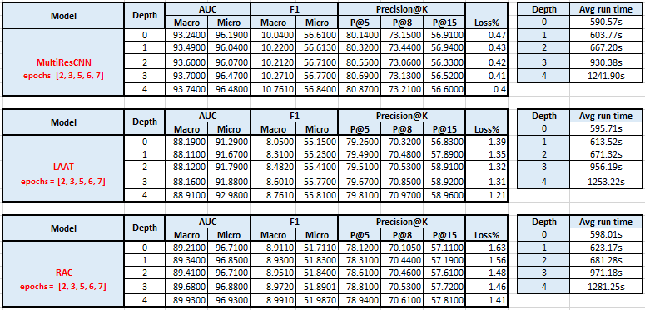
Results Original

Slide 12
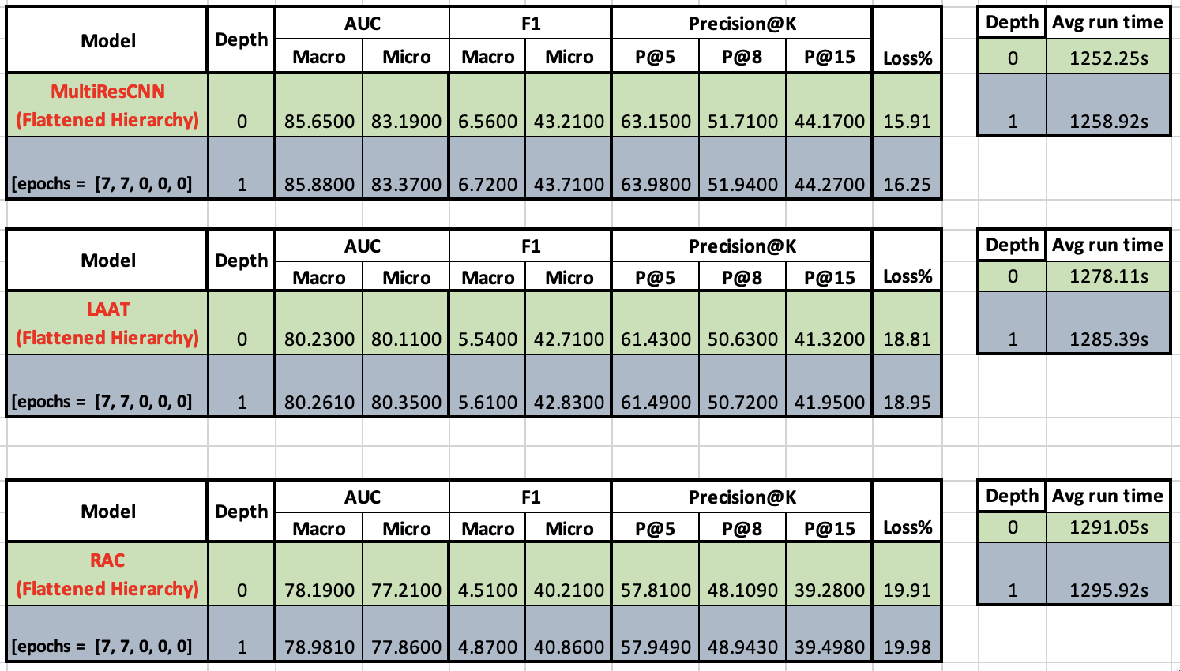
Results New

Slide 13
Results (After Code Modification)
Comparison of original results and reproduced results
Add ablation study – changing hierarchy and loss function
Summarize the results of the reproduction attempts
Compare the reproduced results with the original results

Slide 14
Discussion / Conclusion
Summarize the main points of the presentation
Discuss the implications of the results and their potential impact
The HiCu algorithm is an innovative approach to automated ICD coding that takes advantage of the hierarchical structure of the ICD codes to improve the model's ability to learn complex relationships between the codes, which is difficult to achieve using traditional flat learning approaches.

